Slide 1

Memory Skills Group
Week 2 : Overview of Memory
Rebecca Niebieszczanski (Trainee Clinical Psychologist)
Kirsty Ellis (Assistant Psychologist)
Lesley Stewart (Consultant Clinical Neuropsychologist)
Revised 2021
Grace Sunerton (Assistant Psychologist)
Alice Roblin (Senior Clinical Psychologist)

Slide 2

Welcome!
Notes:
Welcome participants to the group
Explain that the group is for individuals who report difficulties with their memory
Important that we have realistic expectations that the group is not about ‘getting rid’ of our memory difficulties
The group will offer skills and information that will help us to manage these memory difficulties
2 hours with break

Slide 3




Housekeeping:
Notes:
Breaks – including toilet breaks
No recording of the session
Mobile phones on silent/vibrate to minimise distractions

Slide 4

Session Outline
Group rules
Introductions
Hopes, fears and expectations
Aims and overview of the course
Pre-group measures
An overview of cognitive functioning and abilities
Goal setting
Out of session work
Summary

Slide 5

Group Rules
Confidentiality
Respect
Share thoughts, ideas and experiences
Time keeping
Mobile phones
Notes:
Confidentiality – please respect each others information. Please discuss your own thoughts and materials with others but protect the confidentiality of members of the group by keeping discussions to how you feel and your own situation. Limits
Respect each other and allow each other space to talk and share different opinions
Please talk slowly and thoughtfully speaking one at a time so that everyone can hear and follow what is being said
Time keeping – please arrive on time so that the group can start promptly
Please switch mobile phones to silent
Is there anything that you would suggest could help the group to run smoothly?

Slide 6
Introductions:
?
What’s your name? _____________________________
Tell me about yourself: ____________________________________ ____________________________________ ____________________________________
What’s your favourite thing to do? ____________________________________ ____________________________________
What’s the one thing you could not live without? ____________________________________
Page 5

Slide 7

Hopes, Fears, Expectations
What do you hope from this group?
What do you expect from the group?
Any fears about being in the group?

Slide 8
Course aims:
To develop knowledge and understanding of our memory and the process underpinning it
To develop awareness of and share our own difficulties
To develop internal and external strategies to support our memory
To increase knowledge and understanding of the impact of memory difficulties on our wellbeing
To develop an awareness of strategies to support psychological and emotional well-being
To increase our knowledge and understanding of cognitive functioning and abilities

Slide 9
Overview of the course:
Session 1 Introductions and an overview of cognitive abilities
Session 2 Overview of memory
Session 3 External memory enhancement strategies
Session 4 Internal memory enhancement strategies
Session 5 Mood and cognitive functioning
Session 6 Keeping well, course reviews and goodbyes
Notes:
6x 2 hour sessions
The emphasis of this group is active participation and it is equally important to contribute as much as you feel you can.
It is also important that you attend all the sessions, however, if for some reason you can’t attend the group - let us know
Taught materials
Discussions
Exercises and chances to practice
Contact details in booklet if need additional support, talk to facilitators
Facilitators might make notes throughout to remember content of session

Slide 10

Session Outline
Welcome and grounding exercise
Summary of last session
Review of out of session work
Exploring the memory process
Why do people experience memory difficulties?
Out of session work
Summary

Slide 11
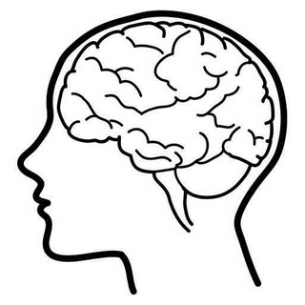
Cognitive Abilities
Memory
Language
Visuospatial Skills
Types of Cognitive Abilities
Attention
Information Processing
Executive Functioning
Notes:
The term cognitive ability is used to describe people’s thinking abilities; including problem solving, concentration and memory. Our minds are made up of lots of these abilities.
We will explore some of these in more detail below; however, for the purpose of this group we will not cover all cognitive abilities.
We all have our strengths as well as areas we find more difficult. Some of you may have completed a cognitive assessment before attending this group which helps us to identify these strengths and areas of difficulty.

Slide 12


Executive Functioning
Planning and organising
Sequencing
Flexible thinking
Self-monitoring
Problem solving
Sometimes I find it hard to multi-task or change what I’m doing
I have trouble planning ahead what I need to do during the day or for specific tasks
Notes:
Executive functioning is a broad term used to describe our ability to regulate and organise our thoughts and activities and effectively make decisions.
Difficulty planning
Difficulty organising
Making decisions
Switching between tasks

Slide 13

Language
Expressive language
Receptive language
Articulation
I often find it hard to find the right words
I have trouble understanding conversations

Slide 14
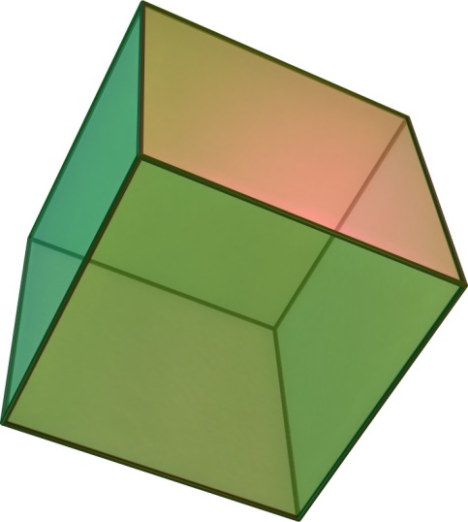
Visuo-Spatial Skills
Represent
Analyse
Manipulate
I often bump into things and find it hard to judge how where things are
I find it hard to figure out how to repair or build things
Notes:
What are visuospatial skills?
Visuospatial skill is the ability to represent, analyze, and mentally manipulate objects. There are two important concepts relating to visuospatial skills:
Spatial relations: the ability to represent and mentally manipulate two-dimensional objects.
Spatial visualization: the ability to represent and mentally manipulate three-dimensional objects.
Why are visuospatial skills important?
Visuospatial skills are very useful in everyday life. Thanks to them, we can estimate the distance between two objects, which can be helpful, for instance, when parking a car to monitor the space between the car and the surrounding obstacles. We also use visuospatial skills when imagining a place or address that someone mentions, or when we mentally rotate objects in order to visualize what they would look like before actually doing it.

Slide 15

Group measures
Notes:
Explain that participants will be asked to complete measures now and at the end of the course. This to monitor any general changes following the group, and to ensure that the group is meeting its’ aims.
Individual responses will not be identifiable. The front sheets will be used to match pre and post measures but will then be removed and shredded.

Slide 16
break

Slide 17
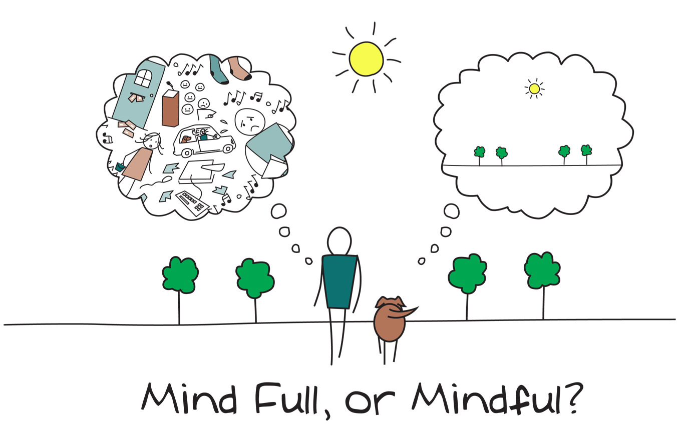
Mindfulness
Notes:
3-minute Mindful Breathing Meditation (Relieve Stress) - YouTube
As we said in the last session, when you come into each session there may be lots of things on your mind. You might have thoughts about what you’ve been doing, what you need to do, maybe some expectations or perhaps worries about what the group itself will be like. Our minds often wander and life is sometimes filled with stresses or worries.
To start off today, and at the beginning of our future sessions, we will carry out a brief breathing exercise. The aim of this is just to help us be more present ‘in the moment’, and give us some time to become more aware of our thoughts, feelings and any physical sensations.
As we’ll see later in the course, this can also support our cognitive functioning and help our memory along with promoting overall well-being. If you have difficulty focusing on the breath (e.g. due to breathing difficulties) then go at a pace that feels comfortable to you, stop the meditation or focus on another part of your body, such as your feet.
Below are some of the core principles of mindfulness:
The ‘being’ mode: Mindfulness says that often we are so caught up in these thoughts about the past and future (the ‘doing’ mode) that we end up not paying attention to what’s happening around us now (the ‘being’ mode).
Self-compassion: We often have so much compassion and empathy for others that we forget to have the same for ourselves. Mindfulness is about extending some of this kindness to ourselves.
Mindfulness can have a positive impact on lots of areas of our lives including:
Emotional wellbeing: becoming more aware of our unhelpful thoughts and feelings and distancing ourselves from these. This can help us to realise that thoughts are just that thoughts! We will talk more about this in sessions 5 and 6.
Physical wellbeing: Becoming more aware of our bodies can be very useful for managing stress and reducing the release of cortisols. This is because we’re often not even aware of the impact of stress on our bodies. We will also discuss this in more detail in another session
Cognitive functioning: Mindfulness can be used to help improve our attention. By becoming aware of our thoughts, feelings and physical sensations we can bring our attention back to the present moment and reduce how much time we spend in automatic pilot. This can actually also help us to train our attention and help us to process and encode information effectively.

Slide 18
The Process of Memory
Attention
First you must focus on something; this includes listening and looking.
Notes:
The process of learning and remembering is quite complex and requires lots of different abilities and skills. This includes attention, information processing, encoding, storage and retrieval.
When we talk about memory or say my memory is bad, its easy to think of memory as one singular function. By being specific about what memory difficulties we notice and what aspects work better can help us to identify where in the process our main difficulties are. Therefore we’re able to come up with more effective and targeted strategies to support memory.

Slide 19

Attention
Notes:
Show videos Colour Changing Card Trick – YouTube
selective attention test - YouTube
After video, explain that if this process is interrupted or affected at any point, it can impact on our ability to recall information. E.g. if someone I having difficulty with their attention they might think they’re forgetting that information when in fact it’s not entering their minds in the first place.

Slide 20

Attention
Focused or selective attention
Sustained attention
Divided attention
Alternating Attention
I start doing something but then get distracted and start doing something else. Then I can’t remember what I was meant to be doing.
My mind often wanders when I read or watch TV. I’ll get to the end of a programme or page and have no idea what I read or watched.
Notes:
Attention is a complex thinking skill. Attention describes the process through which you select something to concentrate on, filter out distractions, maintain concentration and switch it when necessary.
Types of Attention
Focused or selective attention is your ability to choose something to pay attention to while filtering out and ignoring other stimuli like noise.
Sustained attention is your ability to keep concentrating on something over a period of time.
Divided attention is your ability to pay attention to more than one thing at the same time.
Alternating attention is your ability to switch your attention between two or more tasks.
How do you think people with attention difficulties can be affected?
Mind wanders
Find it hard to do more than one thing at once
Easily distracted

Slide 21
The Process of Memory
Attention
First you must focus on something; this includes listening and looking.
Information Processing
Then you have to process and understand that information.
Notes:
The process of learning and remembering is quite complex and requires lots of different abilities and skills. This includes attention, information processing, encoding, storage and retrieval.
When we talk about memory or say my memory is bad, its easy to think of memory as one singular function. By being specific about what memory difficulties we notice and what aspects work better can help us to identify where in the process our main difficulties are. Therefore we’re able to come up with more effective and targeted strategies to support memory.

Slide 22
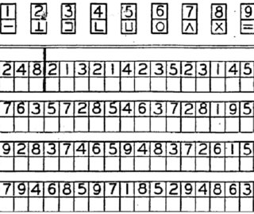
Information Processing

Slide 23

Information Processing
Taking in information
Processing information
Acting on information
It takes me longer to answer questions now. If someone asks me something I have to stop and think about what it means before I can answer.
If someone’s explaining what something means I have to ask them to slow down and repeat it because it takes a while for the information to sink in.
Notes:
Information processing refers to the process through which your mind takes in information, processes that information and acts on. We often talk about speed of information processing which refers to how quickly people are able to do this. For some people this may have slowed down which means that they find it hard to take new information in, especially when they’re trying to concentrate on lots of different things at once. Imagine that your mind works a bit like a computer.
If you have lots of programmes open at the same time this will put pressure on the computer and cause it to slow down. Equally, if you’re using one programme it might be overloaded with information. The same can happen with our minds, especially for people who have reduced speed of information processing. If you overload your mind, information might not go in properly.
Take longer to answer questions
Harder to do things ‘in the head’
Need more time for things to ‘sink in’

Slide 24
The Process of Memory
Attention
First you must focus on something; this includes listening and looking.
Information Processing
Then you have to process and understand that information.
Encoding
That information is then changed into a way that the brain can understand and store it.
Notes:
The process of learning and remembering is quite complex and requires lots of different abilities and skills. This includes attention, information processing, encoding, storage and retrieval.
When we talk about memory or say my memory is bad, its easy to think of memory as one singular function. By being specific about what memory difficulties we notice and what aspects work better can help us to identify where in the process our main difficulties are. Therefore we’re able to come up with more effective and targeted strategies to support memory.

Slide 25

Encoding
Encoding is like finding a place in the cabinet to put your memory
Notes:
When information comes into our memory system (from sensory input), it needs to be changed into a form that the system can cope with, so that it can be stored.
Think of this as similar to changing your money into a different currency when you travel from one country to another. For example, a word which is seen (in a book) may be stored if it is changed (encoded) into a sound or a meaning (i.e. semantic processing).
There are three main ways in which information can be encoded (changed):
1. Visual (picture)
2. Acoustic (sound)
3. Semantic (meaning)

Slide 26
The Process of Memory
Attention
First you must focus on something; this includes listening and looking.
Information Processing
Then you have to process and understand that information.
Encoding
That information is then changed into a way that the brain can understand and store it.
Storage
Once encoded, the information is stored into your memory.
Notes:
The process of learning and remembering is quite complex and requires lots of different abilities and skills. This includes attention, information processing, encoding, storage and retrieval.
When we talk about memory or say my memory is bad, its easy to think of memory as one singular function. By being specific about what memory difficulties we notice and what aspects work better can help us to identify where in the process our main difficulties are. Therefore we’re able to come up with more effective and targeted strategies to support memory.

Slide 27

Storage
Storage is keeping the memory in your ‘filing cabinet’
Notes:
This concerns the nature of memory stores, i.e., where the information is stored, how long the memory lasts for (duration), how much can be stored at any time (capacity) and what kind of information is held. The way we store information affects the way we retrieve it.
Short-term Memory - Most adults can store between 5 and 9 items in their short-term memory. Information can only be stored for a brief duration in STM (0-30 seconds).
Long-term Memory – can last a lifetime.

Slide 28
The Process of Memory
Attention
First you must focus on something; this includes listening and looking.
Information Processing
Then you have to process and understand that information.
Encoding
That information is then changed into a way that the brain can understand and store it.
Storage
Once encoded, the information is stored into your memory.
Retrieval
Once it has been stored, we must be able to pull the information back out; as and when we need it.
Notes:
The process of learning and remembering is quite complex and requires lots of different abilities and skills. This includes attention, information processing, encoding, storage and retrieval.
When we talk about memory or say my memory is bad, its easy to think of memory as one singular function. By being specific about what memory difficulties we notice and what aspects work better can help us to identify where in the process our main difficulties are. Therefore we’re able to come up with more effective and targeted strategies to support memory.

Slide 29

Retrieval
Retrieval is going into your ‘filing cabinet’ and picking the right memory to take out

Slide 30
The Process of Memory
Attention
First you must focus on something; this includes listening and looking.
Information Processing
Then you have to process and understand that information.
Encoding
That information is then changed into a way that the brain can understand and store it.
Storage
Once encoded, the information is stored into your memory.
Retrieval
Once it has been stored, we must be able to pull the information back out; as and when we need it.
Notes:
The process of learning and remembering is quite complex and requires lots of different abilities and skills. This includes attention, information processing, encoding, storage and retrieval.
When we talk about memory or say my memory is bad, its easy to think of memory as one singular function. By being specific about what memory difficulties we notice and what aspects work better can help us to identify where in the process our main difficulties are. Therefore we’re able to come up with more effective and targeted strategies to support memory.

Slide 31
break

Slide 32
Different types of memory
Working Memory: is your ability to temporarily hold information while manipulating it in your mind. An example of this is mental arithmetic
Immediate Memory or Short –Term Memory: is your ability to remember information for a few seconds or minutes such as remembering a phone number for long enough to dial it
Delayed or Long-Term Memory: refers to your memory for information over longer periods of time. For example your ability to remember things from years ago.

Slide 33


Different types of memory
Visual Memory: involves things that you have seen such as faces, objects and pictures.
Verbal Memory: is your memory for things you’ve heard or read.

Slide 34
What kind of difficulties might someone with memory difficulties experience?

Slide 35
I can remember things that people said years ago but I can’t seem to remember what people said or what happened yesterday
I’m able to recognise people’s faces but I find it hard to remember their names.
I can never seem to remember my appointments
I find it hard to remember what I just did, even if it was two minutes ago

Slide 36

Why do we experience memory difficulties?
A head injury or other injury to the brain
Some conditions such as epilepsy
Neurological conditions such as Multiple Sclerosis or Alzheimer’s disease
Stroke
Shortage of oxygen to the brain, for example because of a heart attack
Physical difficulties such as hearing loss or difficulties with vision
Some people notice difficulty recalling information as they get older.
Feeling tired or fatigued
Lifestyle choices
Stress
Low mood or anxiety
A difficult experience such as the death of a friend or relative.

Slide 37
How are people with memory difficulties affected?
Our mood or emotions. For example, some people might feel anxious, frustrated or low because of their difficulties
Our relationships – sometimes it can put strain on our relationships with friends or family
It might make us feel less motivated to do the things we need to do or enjoy in life
We might lose confidence to try new things
Work.

Slide 38
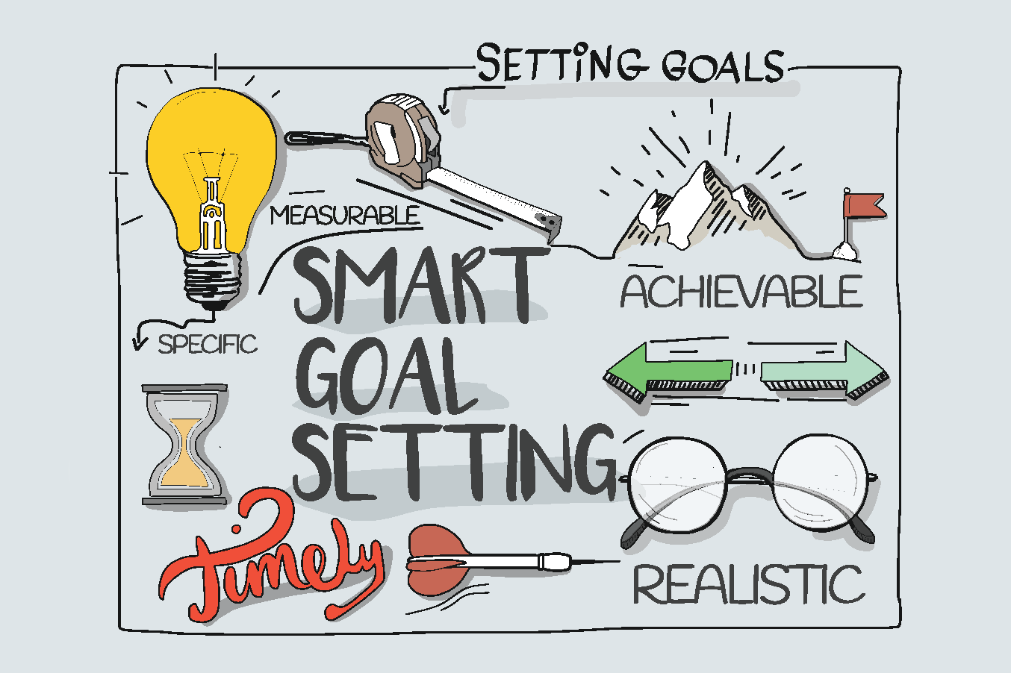
Goal Setting
Brainstorm
Re-examine
SMART
Action Plan
Obstacles
Reward
Notes:
Setting a major goal can be very stressful or even overwhelming. This is the type of goal that you will always start ‘tomorrow’ or ‘next week’, but those times never seem to come.
Learning to break your goals into small tasks will help you overcome the stress and procrastination they create. Think about taking a ‘stepped approach’, 1 step at a time!
Brainstorm: decide what you want to do. Identify goals for home, personal development etc.
Re-examine: once you;ve generated this list, go back and look at it closely identifying which goals are realistic and which might be unobtainable.
Rewrite the goals in terms of an outcome: make your goal a SMART goal!
Write out an action plan: break your goal into small steps that are needed to achieve it.
Identify obstacles: these are the things that will get in the way of achieving your goals.
Build in rewards and visualise the end result: have a clear mental picture of what you want to achieve to increase motivation.

Slide 39
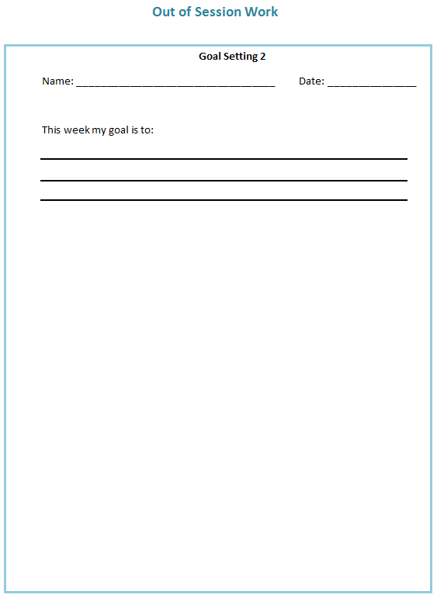
Out of Session Work
Weekly
SMART goals
Review in following session
Notes:
Helpful to think about own difficulties and to identify any strategies that are already providing to be useful, share them with the group

Slide 40

Summary
Hopes, fear, expectations
Overview and aims of the course
Cognitive abilities
Mindfulness
Process of memory
Different types of memory
Why we experience memory difficulties
How memory difficulties can affect you

Slide 41
Thank you for attending
Grace Sunerton, Assistant Psychologist
Jessica Haselhurst, Trainee Clinical Psychologist
01782 275188
Notes:
Contact details if you are having difficulties with the programme. There will also be space to ask any questions and explore with us your difficulties within the group if you feel comfortable sharing these.

